Slide 1
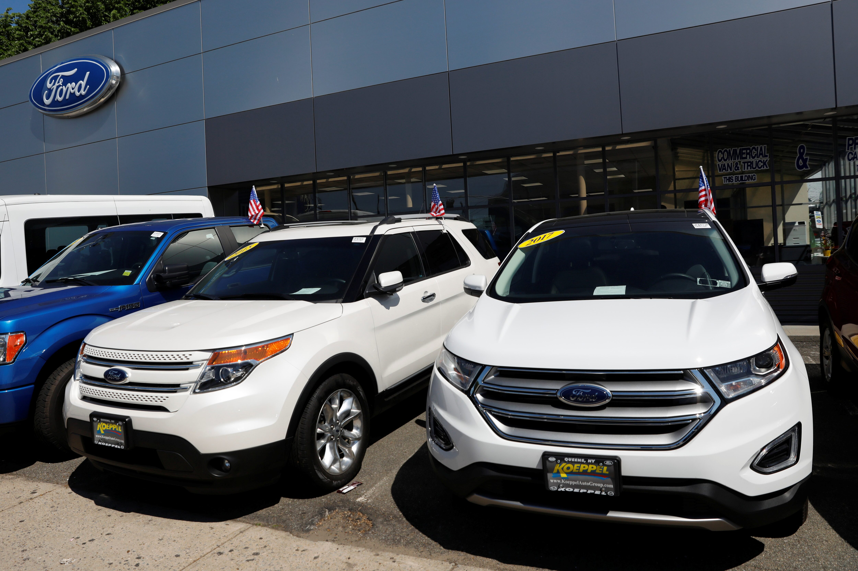
AUTOMOBILE SALES ANALYSIS
BY NAFISAT ABDULKAREEM
20th JANUARY 2025

Slide 2
TABLE OF CONTENTS
Introduction.
Objectives
Data cleaning and Transformation process.
Data analysis.
Key insights.
Recommendation.

Slide 3
The automobile sales dataset was downloaded from Kaggle and offers a detailed look at the car market, providing insights into consumer purchasing habits and industry trends. Containing data on Various vehicle sales.
By looking at past sales data and current market conditions, automobile sales analysis helps businesses make good decisions. It can also identify opportunities to sell more cars and make customers happier.

Slide 4
DATA CLEANING AND TRANSFORMATION PROCESS
Reviewed data from errors and missing values
I created a standardized date format and removed duplicate

Slide 5
OBJECTIVES
Total Sales Across Countries
Total sales within The Year
Sales by month
Revenue by product
Sales By Size
Sales by customer
Sales By status

Slide 6
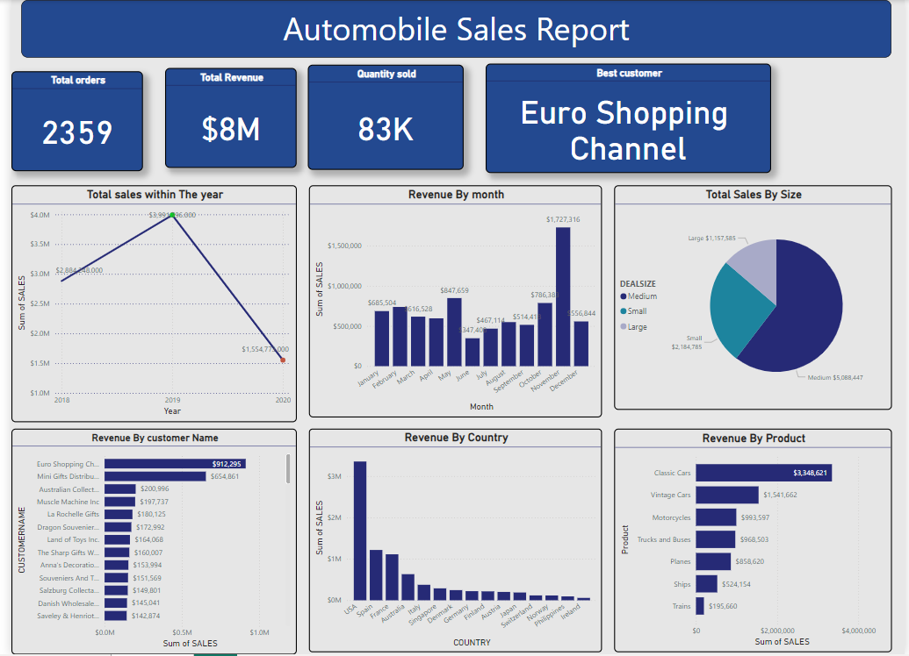

Slide 7
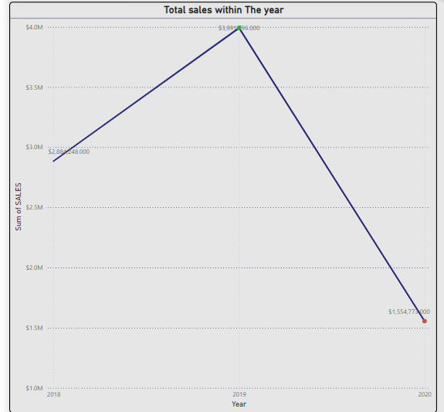
KEY FINDINGS
From this analysis, it shows that 2019 has the most sales and 2020 has the least sales

Slide 8
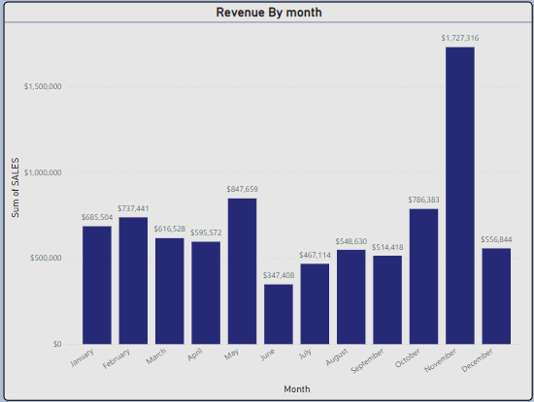
KEY FINDINGS
According to this chart November generated more revenue with the total sum of 1,727,316, compared to other month and June has the least revenue with the sum of 347,408

Slide 9
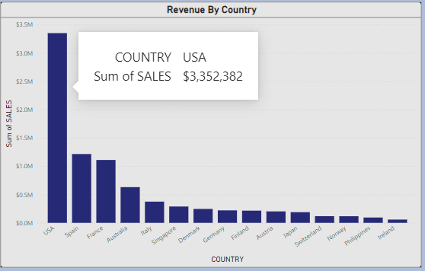
KEY FINDINGS
The Analysis here displays that USA generate more revenue while Ireland generate least revenue to the company

Slide 10
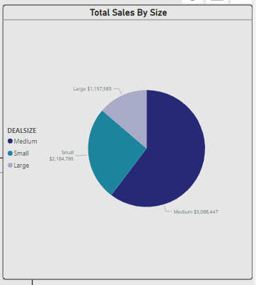
KEY FINDINGS
From the insight, this chart shows that medium vehicles has the highest sales record and large vehicles has the least sales

Slide 11
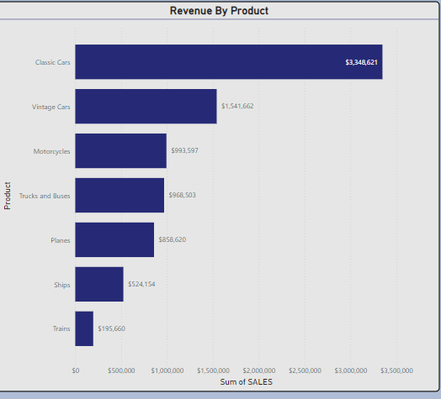
KEY FINDINGS
This chart displays that classic chart generate more revenue while trains generate list revenue to the company

Slide 12
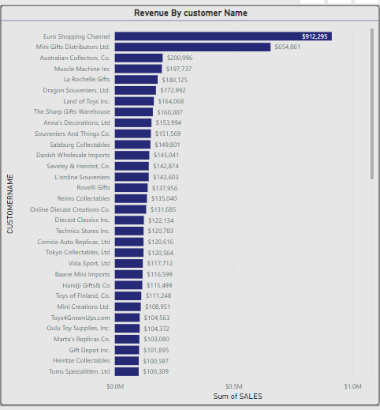
KEY FINDINGS
This chart shows customer purchasing habit to the company where by Euro shipping has the highest purchase recorded in the company while toms specialization Ltd has the least purchase

Slide 13
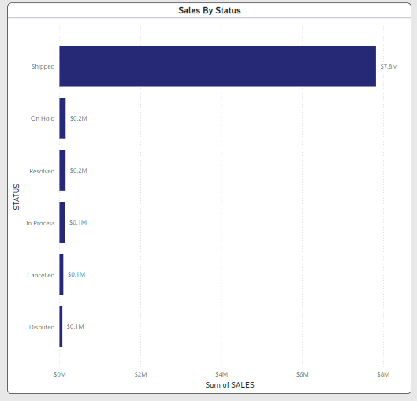
KEY FINDINGS
This chat indicate that most of the product purchased by customers are shipped

Slide 14
Recommendations
Optimize Sales Strategies for the month of November such as launching black Fridays.
Since Euro shipping is the best customer, the company should dedicate partnership such as exclusive deals, high based discount to encourage continued collaboration..
The company should prioritize manufacturing more medium size vehicles.
Provide Packages for both individuals and client such as Euro shipping.
The company should increase its marketing for classic car
Open service centers in high demand Location and
establish more regional centers in other country to reduce cost of shipping

Slide 15
THANK YOU

